Slide 1
Maximize Your Reach, Take Your Content Anywhere Cost-Effectively
Pravin Udho, Managing Sales Director, Intelsat
October 2024

Slide 2
Global Trends in
Video Consumption
+79%
HD/4K
Video accounts for 69% of global mobile traffic worldwide and slated to increase to 79% by 2027
Expectation for affordable access to high quality/resolution content
Evolving into a hybrid model (linear, streaming)

Slide 3
Africa Unique Opportunities
Growing Economy
More content. More viewers
World’s youngest population
Growth
of Satellite TV
Africa is one of the world's fastest growing TV markets

Slide 4
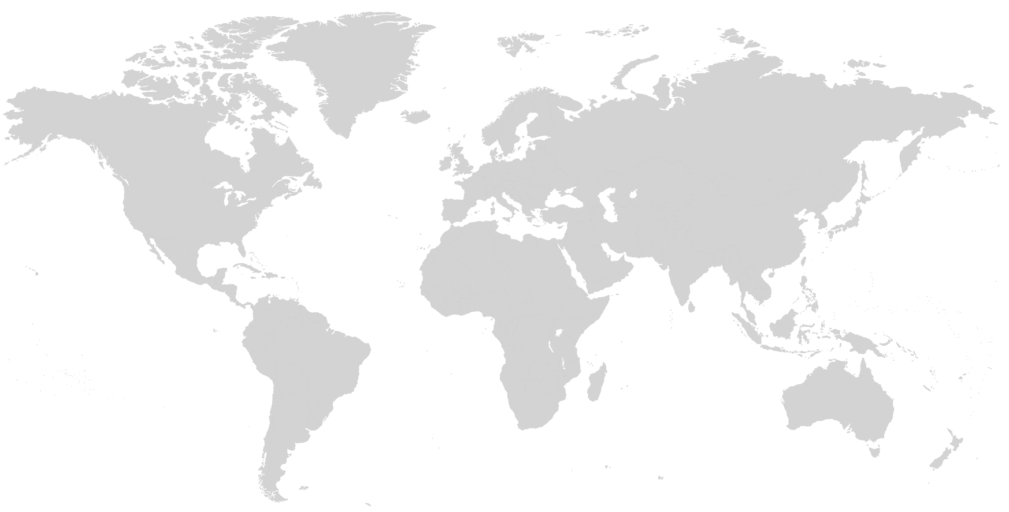
The African Diaspora
Europe
14M+
49M+
North America
20M+
Asia
110M+
South America
Out of ~1.4BN people in Africa, more than 200 million people of African descent live outside the continent
© Intelsat | Confidential & Proprietary |

Slide 5
Insight into African Audiences
Linear TV remains strong and continue to perform well
DTH and DTT are (and will remain) the main vectors for linear content distribution
Africa’s multi-cultural population wants diverse content relevant to them
HD programming is a growing opportunity as most people are interested in higher quality.
Most viewership comes from urban areas of population & a growing demand from non-urban areas
Satellite remains the best enabler in the African media market

Slide 6
Leverage the Power
of Satellite
A demand for more diverse content in more places, coupled with the ability
to deliver reliable, high-quality coverage almost anywhere makes satellite the only
choice for programmers in Africa.
More Content
More Coverage
More Flexibility
More Revenue

Slide 7
Welcome to a World of More with Intelsat

Slide 8
One Global Network for a Hyperconnected World
100+
Teleports & POPs
20
Global Offices
300K+
Km of Fiber
55+
Satellites
99%
Coverage of world’s populated regions
Largest global integrator of satellite and terrestrial communications network

Slide 9
Take Your Video Anywhere

Slide 10
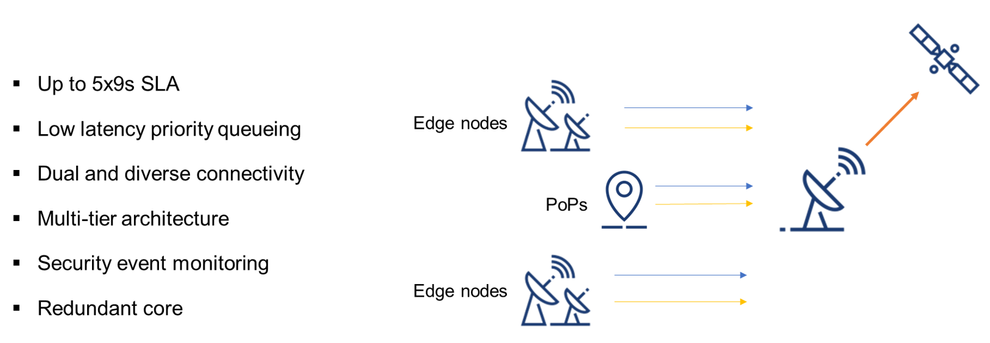
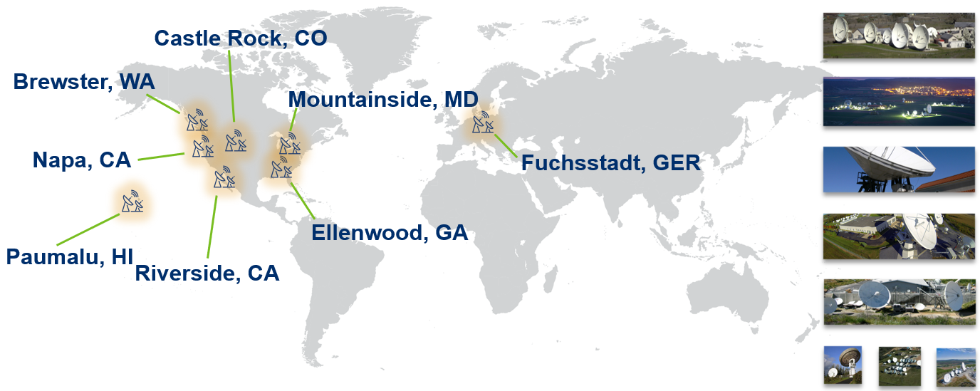
IntelsatOne Managed Media Products
End-to-end broadcast transmission from content aggregation to global distribution
+300,000 km of Fiber
+100 Teleport-Data Centers & PoPs
12 MCPC platforms
Uplinks & Downlinks

Slide 11
IntelsatOne IP
Flexible IP transport solution that is fully integrated into the Intelsat Global Media network.
Protocols support: RIST, SRT, UDP, RTP, RTMP, Zixi
IntelsatOne IP PoP
IntelsatOne IP PoP
Public Internet
IntelsatOne IP
IntelsatOne Fiber or Public Internet
Public Internet
IntelsatOne IP PoP
Example of Managed Primary Distribution

Slide 12
Reach New and Exciting Audiences

Slide 13
With access to over 35 video neighborhoods, connect to the world’s prime cable, broadcast, and DTH systems.
Capture and Expand Your Audience with Intelsat’s Video Neighborhoods
North America
100+M
households
Europe
23M
households
Asia pacific
260+M
households
Latin America
69M
households
Sub Sarahan Africa
45+M
viewers
Middle East and North Africa
14M
households
© Intelsat | Confidential & Proprietary |
13

Slide 14
Over 45 million viewers in Africa already receive FTA channels from IS-20
IS-20 is Intelsat’s Premier Video Neighborhood in Africa
Ghana
3.9M FTA viewers
Ethiopia
2.9M FTA viewers
Nigeria
22M FTA viewers
Kenya
2.3M FTA viewers
Tanzania
2.2M FTA viewers
S. Africa
8.9M FTA viewers
© Intelsat | Confidential & Proprietary |
14

Slide 15
Trusted partner and proven innovator in satellite connectivity
Trusted partner
Longstanding relationships with track record of reliable service across industries
Proven innovator
Satellite communications pioneer from first commercial service to next generation solutions
© Intelsat | Confidential & Proprietary |
15

Slide 16
Our Unified Network Vision
Software-defined, multi-layer, multi-orbit 5G Network of Networks
GEO
Excellent Economics
Highest performance density
MEO / LEO
Optimal access to lower latency, security and advanced technology
Modem | Terminals | Cloudification
Fastest way to positively impact customer experience
© Intelsat | Confidential & Proprietary | 16

Slide 17
Thank You

